Slide 1
fMRI 1st Level Analysis: Basis functions, parametric modulation and correlated regression
MfD 22/11/17
Kate Ledingham and Arabella Bird
Notes:
If this is anyone’s first time, the aim of these seminars is to provide a basic introduction to human brain imaging analysis methods. The last few weeks have covered the basis of the BOLD signal used in fMRI, the stages of preprocessing, and an introduction to 1st level analysis (design matrix, contrasts and inference, GLM). Today we are continuing to focus on 1st level analysis – specifically the concepts and practice of basis functions, parametric modulation and correlated regression

Slide 2
Temporal basis functions
Definitions
Basis function – combine a number of simple functions to describe a more complex function
E.g. Fourier analysis – the complex wave can be decomposed into the sum of the three simple waves
}
Notes:
So what is a basis function? It is a recognised set of simple functions which together can be summated to describe a more complex function. If you’ve come across Fourier analysis you’ll know that this is where any complex wave is made up of oscillating/trigonometric cosine waves of different wavelengths.

Slide 3
Temporal basis functions
Purpose
In fMRI analysis, it is necessary to describe a complex function
This complex function is of % BOLD signal change over time
Peak
Brief
Stimulus
% BOLD signal change over time =
canonical haemodynamic response function (HRF)
Undershoot
Initial
Undershoot
Notes:
So what is the purpose of using basis sets in fMRI analysis? Well, in fMRI we are measuring the BOLD impulse response, which is a function of blood oxygenation, flow and volume. Last week we saw that we need to use this function, the HRF, and so today we will think further about how to improve our model to fit the data better, given the variability in a biological signal, which can vary even within one subject due to things as simple as having a cup of coffee, for instance.

Slide 4
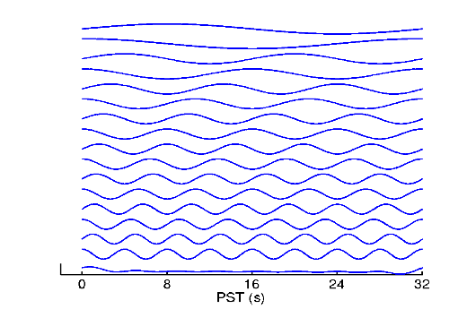
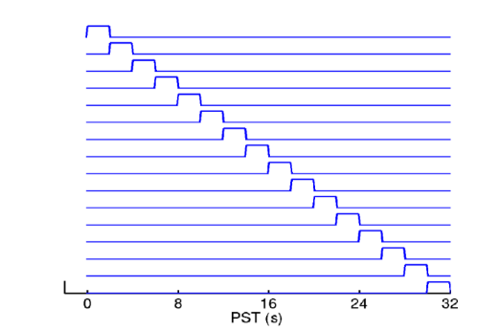
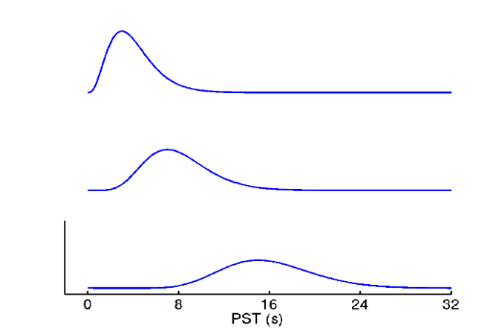
Temporal basis functions
Purpose
Various different basis sets can approximate the signal
Best practice: to use functions that relate to our knowledge of the shape of the HRF
2 gamma functions provide best guess of BOLD response
Fourier basis set
Finite impulse response set
Gamma functions
Notes:
The purpose of basis functions is to approximate the BOLD signal. There are multiple different basis sets which all have the potential to estimate the signal, for example the fourier basis set which we’ve come across already or the finite impulse response set. The fourier basis set or the finite impulse response set can model the data perfectly, but the downside is that they are actually too flexible, and thus hard to interpret, because we want to make some inference on the amplitude of the response. Statistically speaking, we want to capture the most information with the fewest functions (ie fewest degrees of freedom). The best way to go about choosing the most appropriate basis set is to use our knowledge of the shape of the HRF, and use the functions that relate best to that. We can see from these diagrams that one gamma function alone provides a reasonably good fit to the HRF. We can see that they have an incline, a peak and a decline, are asymmetrical and can be set at different lag times; all features of the canonical HRF. In order to accommodate for the undershoot of the HRF, we need to add 2 gamma functions together, which gives us a preliminary best guess of the BOLD response.
Temporal basis functions are therefore important because they give us a good balance between conventional multi-linear regression models with one stimulus function per condition and very flexible models such as the fourier basis or finite impulse response set with a parameter for each time point following the onset of a condition or trial type. Figure 6 illustrates this graphically (see Figure legend). In summary, temporal basis functions give us useful constraints on the form of the estimated response that retain both the
flexibility of FIR models and the efficiency of single regressor models.

Slide 5
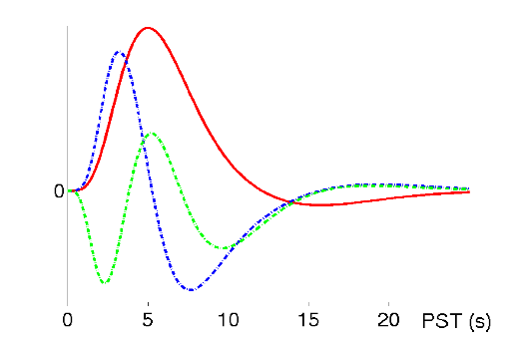
Temporal basis functions
Informed basis set (Friston et al, 1998)
2 gamma functions → HRF best guess
Multivariate Taylor expansion → variability
Temporal derivative (blue)
Dispersion derivative (green)
Notes:
After we’ve got this preliminary best guess of the HRF, we need some functions which will allow for the variation inevitable in a biological signal. These functions are known as the Taylor expansion, and so when we combine the 2 gamma functions with the Taylor expansion, we have both a best guess of the BOLD response, and ability to capture variability in both time and width. The temporal derivative, seen in blue, can model small differences in the latency of the peak response and the dispersion derivative (green) can model small differences in the duration of the peak response

Slide 6
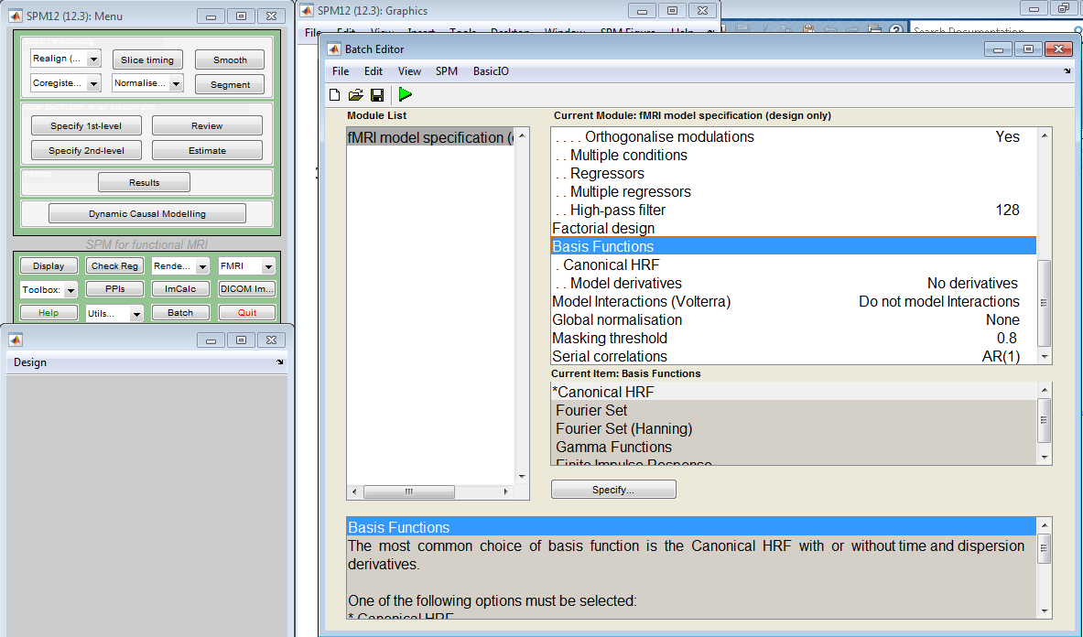
Temporal basis functions
Using SPM
Notes:
Now that we understand the theory behind basis functions, it is important to know how to go about using this in SPM. In the Batch Editor you can select Basis Functions, and then the Canonical HRF, and then choose to include the time and dispersion derivatives that we saw in the Taylor expansion. This theory and practical demonstration will hopefully be a useful taster in how to go about using basis functions in first level analysis of our fMRI data that I’m sure a lot of us in the faculty will be collecting this year and in future research.

Slide 7
Parametric modulation
Parametric regressors
Parametric v Factorial
Polynomial expansion: Constant (average effect across trials) + linear component + quadratic component
Parametric experimental design
Useful for paradigms with continuous variables, or stimuli with multiple dimensions
Useful if you are anticipating that the amplitude of the response may be different for each stimulus dimension or will change over time
Eg: reward- based decision-making/model based learning (see O-Doherty 2007)
Notes:
Now it is important to consider our experimental design in light of our analysis methods. A parametric experimental design is useful for paradigms with continuous variables, where every variable has its own column in the design matrix, corresponding to one independent stimulus dimension of interest. The continuous variable is represented numerically within one column.
Parametric experimental design is also useful for complex stimuli with a number of stimulus dimensions as they can be modelled by a set of parametric regressors tied to the presentation of each stimulus (e.g a tone can be described in terms of pitch, amplitude, duration, location etc). This means that we can look at the contribution of each stimulus dimension independently, and can thus test predictions about the direction and scaling of BOLD responses as accounted for by these different dimensions.

Slide 8
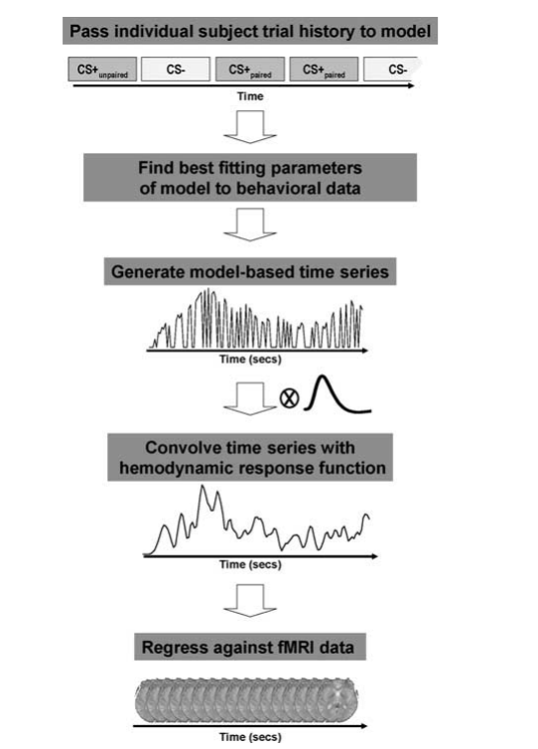
O’Doherty et al 2007

Slide 9
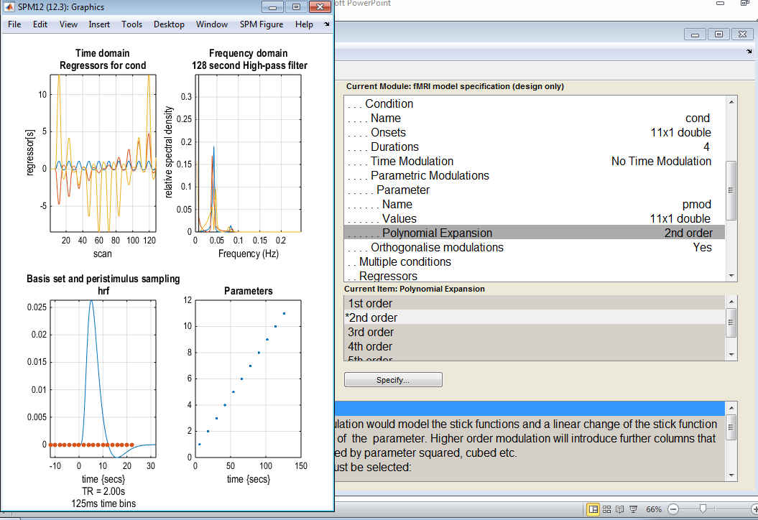
Parametric modulation
Specifying parametric regressors in SPM
Polynomial expansion: Constant + linear component + quadratic component
Notes:
Now that we understand the theory behind parametric modulation, it is important to know how to go about using this in SPM. In the Batch Editor you can select parametric modulations, and then parameter, and then polynomial expansion. Then we can see in the output graphics the regressors for each condition, which will thereby exhibit a constant, a linear component, and a quadratic component.

Slide 10
Correlated regressors
GLM
Y = β0 + β₁X₁ + β₂X₂ + ε
Y = BOLD response, X₁ = visual component X₂ = motor response
Confounds
X₁ may be confounded with X₂ due to their temporal dependence (eg. Button press and visual stimulus)
Mumford et al., 2015
Solution
Orthogonalisation (SPM carries out serial orthogonalisation)
Careful experimental design (toolboxes “NeuroDesign”)
Notes:
So we’ve heard that correlated regressors can cause problems with interpretation, and we can explain this by using an example. If we were to conduct an experiment where participants had to attend to a shape on a screen and respond to its sudden movement with a button press, both those events would occur with high temporal proximity. Thus when analysing which brain region is most active and thereby responsible for visual perception of movement, it would not be immediately possible to distinguish whether it was due to the visual cortex, or the motor cortex, as both would be highly correlated.
We know that in the GLM if two predictors are correlated, then their regressors will also be correlated. Collinearity between the regressors will mean that we cannot distinguish which changes in the BOLD response are explained by X₁ and which are accounted for by X₂. This makes it difficult to assign responsibility to one of them, as they share descriptive variability. This may lead to misinterpretations of activations in certain brain areas.
A good explanation of correlated regressors in fMRI models can be found in this paper by Jeanette Mumford et al, which shows the impact of collinearity and ways in which you can address it. The paper focuses on the appropriate uses of orthogonalisation, and the way in which packages like SPM and FSL manage it. They argue that where the model includes parametric modulation, orthogonalisation is appropriate. In fact SPM automatically performs orthogonalisation for parametrically modulated regressors in versions 8 and older. In these cases, SPM carries out serial orthogonalisation within each condition. This means that the order in which you put the parametric modulators is important – you must put the most important ones in first.
Another way to manage correlated regressors is through experimental design. This might include asking the participant not to respond for some specified trials, thus providing null trials. There is a toolbox called NeuroDesign which introduces jittering to optimise your design to try and make factors of interest as orthogonal as possible. You can also carry out efficiency calculations to compute the amount of variance associated with each parameter estimate – the paper above explains how to do this.
So once we’ve successfully completed first level analysis, we may be able to form a conclusion about our original hypothesis for one participant.

Slide 11
Many thanks to Dr Guillaume Flandin
Sources
Previous MfD lecture slides
O'Doherty JP, Hampton, A, and Kim, H. (2007) Model-Based fMRI and Its Application to Reward Learning
Mumford JA, Poline J-B, Poldrack RA (2015) Orthogonalization of Regressors in fMRI Models. PLoS ONE10(4): e0126255
Statistical Parametric Mapping: The Analysis of Functional Brain Images (2007)
Next week: 2nd level analysis
Any questions?

